Slide 1
Addition and Multiplication Theorem

Slide 2
The rule of addition and the rule of multiplication are two important rules of probability that describe how probabilities are calculated for multiple events

Slide 3
Addition Theorem
The rule of addition (also known as the "OR" rule) states that the probability of two or more mutually exclusive events occurring is the sum of the probabilities of the individual events occurring.
Example 1: if you have a coin and you want to know the probability of it landing on heads "or" tails, then the answer would be 1/2 + 1/2 = 1. This means that there is a 100% chance that either heads or tails will occur.
Example 2: If you have two events, A and B, and the probability of event A occurring is 0.40 and the probability of event B occurring is 0.30, the probability of events A "or" B occurring is 0.40 + 0.30 = 0.70.

Slide 4
Addition Theorem
If events are not mutually exclusive, it means that they can happen at the same time. In this case, the rule of addition says that the probability of either event happening is the sum of each event's probabilities minus the probability of both events happening simultaneously.
Example 3: If the probability of event A happening is 30% and the probability of event B happening is 50%, and the probability of both events happening at the same time is 10%, the probability of either event A or event B happening is 30% + 50% - 10% = 70%.

Slide 5
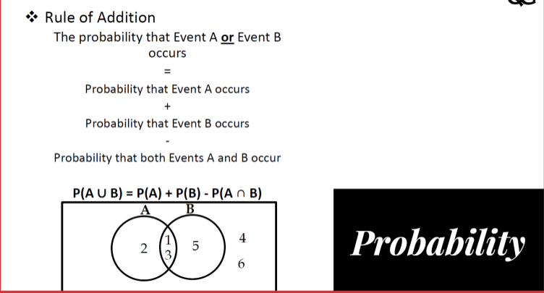
Addition Theorem

Slide 6
Multiplication Theorem
The multiplication rule (also known as the "AND" rule) states that the probability of two independent events occurring together is equal to the product of their individual probabilities.
Example 1: If you have two events A and B, and the probability of event A occurring is 0.40 and the probability of event B occurring is 0.30, the probability of events A "and" B occurring simultaneously is 0.40 * 0.30 = 0.12. This is because the probability of both events occurring simultaneously is the product of the probabilities of the individual events occurring.
Example 2: If you want to calculate the probability of getting a head on the first coin flip and tails on the second coin flip, you will use the rule of multiplication to determine that the probability is 0.25 because the probability of getting heads on the first coin flip is 0.50. The probability of getting tails on the second coin flip is also 0.50, and the probability of both events occurring simultaneously is 0.50 * 0.50 = 0.25.

Slide 7
Multiplication Theorem
Example 3: Suppose you have a bag containing 3 red balls and 2 green balls. If you want to find the probability of drawing a red ball (then put this back in the bag: With replacement) and in the second draw you get a green ball, you would use the rule of multiplication:
P(red AND green) = P(red) * P(green) = (3/5) * (2/5) = 6/25 = 0.24
In this example, the probability of drawing a red ball in the first selection does NOT affect the probability of the green ball in the second pick, as the first selection (red ball) is put back in the bag. The two events were independent events, meaning that one event's occurrence does not affect the probability of the other event occurring.
Example 4 Suppose you have a bag containing 3 red balls and 2 green balls. If you want to find the probability of drawing a red ball and in the second draw you get a green ball (without replacement), you would use the rule of multiplication:
P(red AND green) = P(red) * P(green|red) = (3/5) * (2/4) = 6/20 = 0.30
In this example, the probability of drawing a red ball in the first selection DOES affect the probability of the green ball in the second pick, as the first selection (red ball) is NOT put back in the bag. This reduces the total number of balls in the bag to 4 ( 2 Red and 2 Green). The two events are dependent events, which means that the occurrence of one event affects the probability of the other event occurring

Slide 8
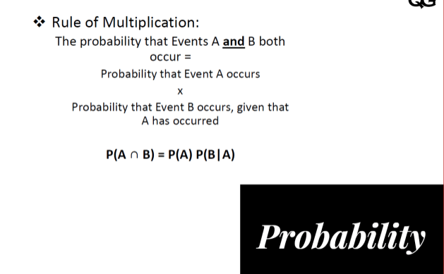
Multiplication Theorem

Slide 9
Summary
The rule of addition for mutually exclusive events:
P(A or B) = P(A) + P(B)
The rule of addition for non-mutually exclusive events:
P(A or B) = P(A) + P(B) - P(A and B)
The rule of multiplication for dependent events:
P(A and B) = P(A) * P(B/A)
The rule of multiplication for non-dependent events:
P(A and B) = P(A) * P(B

